Slide 1
ROYAL ARCHIVE OF CODE
WEEKLY MEAL PLANNER
& GROCERY GENERATOR
A Java Project Demonstration · Mapped to CO1 – CO6
TEAM NO
Chava Yashas
2620030034
Chakirala Praneeth
2620040094

Slide 2
OVERVIEW
Abstract
This project helps users plan meals for a week and prepare a grocery list.
01
02
03
04
Users choose meals for each day.
The system collects the ingredients needed for those meals.
It combines repeated ingredients and shows one shopping list.
This saves time, reduces food waste, and makes shopping easier.
MAIN IDEA
Plan meals first, then generate the grocery list automatically.

Slide 3
PROBLEM
Understanding the Problem Statement
PROBLEM
BASIC STEPS
People often decide meals day by day and may forget ingredients while shopping.
1
Select meals for Monday to Sunday.
2
Read the ingredients for each meal.
OUR SOLUTION
The application stores meal choices, checks their ingredients, and creates a weekly grocery list.
3
Combine the ingredients and count quantities.
4
Display the final grocery list.
EXPECTED RESULT A simple weekly plan and an organized shopping list.

Slide 4
CO 1 · FOUNDATIONS
Java Fundamentals for Meal Logic
Java fundamentals help the meal planner store and process information.
JAVA EXAMPLE
import java.util.Scanner;
public class MealChoice {
public static void main(String[] args) {
boolean mealSelected = true;
boolean ingredientsKnown = true;
if (mealSelected && ingredientsKnown) {
System.out.println("Meal added");
} else {
System.out.println("Check meal details");
}
}
}
Variables – store meal names and ingredient details
Data types – represent text, numbers and true/false values
Operators – compare values and combine conditions
Scanner – can accept meal choices from the user
EXAMPLE RULE
If a meal is selected and its ingredients are known, add them to the plan.

Slide 5
CO 2 · CONTROL FLOW
Decisions and Repetition
Control-flow statements decide what the program does next.
JAVA EXAMPLE
public class WeeklyPlan {
public static void main(String[] args) {
String[] days = {
"Mon", "Tue", "Wed", "Thu",
"Fri", "Sat", "Sun"
};
for (int i = 0; i < days.length; i++) {
System.out.println(
days[i] + ": choose a meal"
);
}
}
}
if-else – checks whether a meal choice is valid
Loop – repeats the process for seven days
continue – skips an empty meal entry
break – stops a search when an item is found
EXAMPLE
Check each day and display its selected meal.

Slide 6
CO 3 · ARRAYS & METHODS
Organizing the Week
An array can store the seven days of the week. A method can display the meal plan. This keeps the program organized and avoids repeating the same code.
JAVA EXAMPLE
public class MealPlanner {
public static void main(String[] args) {
String[] days = {"Mon", "Tue",
"Wed", "Thu", "Fri", "Sat", "Sun"};
String[] meals = {"Rice", "Pasta",
"Salad", "Soup", "Curry", "Wrap", "Dosa"};
showPlan(days, meals);
}
static void showPlan(String[] d, String[] m) {
for (int i = 0; i < d.length; i++)
System.out.println(d[i] + " - " + m[i]);
}
}
Mon
Tue
Wed
Thu
Fri
Sat
Sun
Rice
Pasta
Salad
Soup
Curry
Wrap
Dosa
days[ ] + meals[ ] → showPlan(days, meals)
EXAMPLE OUTPUT
Monday - Vegetable Rice;
Tuesday - Pasta

Slide 7
CO 4 · OOP
Classes, Objects and Encapsulation
A class is a blueprint for creating objects. A Meal object stores one meal name. A constructor sets the name when the object is created. Encapsulation keeps the name private and lets us read it using a getter method.
JAVA EXAMPLE
class Meal {
private String name;
Meal(String name) {
this.name = name;
}
String getName() {
return name;
}
}
public class MealPlanner {
public static void main(String[] args) {
Meal breakfast = new Meal("Idli");
System.out.println("Meal: " + breakfast.getName());
}
}
WHY IT HELPS
Keeps meal details organized
Makes code easier to reuse
Protects data from direct changes
EXAMPLE
Meal breakfast = new Meal("Idli");
Output: Meal: Idli

Slide 8
CO 5 · TEXT & FILES
File Handling to Build the List
CO5 applies text processing and file handling to generate a reliable grocery list.
JAVA EXAMPLE
import java.nio.file.*;
import java.util.*;
import java.io.IOException;
public class GroceryGenerator {
public static void main(String[] args) throws IOException {
Path input = Path.of("meals.txt");
Path output = Path.of("grocery.txt");
Map<String, Integer> grocery = new TreeMap<>();
for (String line : Files.readAllLines(input)) {
if (line.isBlank()) continue;
for (String item : line.split(",")) {
String name = item.trim();
if (!name.isEmpty())
grocery.merge(name, 1, Integer::sum);
}
}
StringBuilder list = new StringBuilder();
grocery.forEach((name, count) ->
list.append(name).append(": ")
.append(count).append("\n"));
Files.writeString(output, list.toString());
System.out.println("Grocery list saved!");
}
}
HOW IT WORKS
Read meal ingredient records from a file.
Split each line into ingredient names.
Trim spaces and ignore blank values.
Count repeated ingredients in a sorted map.
Save the final list to grocery.txt.
MEALS.TXT
GROCERY.TXT
Rice, Tomato, Salt
Rice, Onion, Salt
Onion: 1
Rice: 2
Salt: 2
Tomato: 1

Slide 9
CO 6 · COLLECTIONS & STREAMS
Counting Ingredients with Streams
CO6 collections and streams help organize meal and ingredient data.
JAVA EXAMPLE
import java.util.*;
import java.util.stream.*;
public class WeeklyGrocery {
public static void main(String[] args) {
List<String> meals = List.of(
"Rice, Tomato, Salt",
"Rice, Onion, Salt",
"Pasta, Tomato"
);
Map<String, Long> grocery = meals.stream()
.flatMap(line -> Arrays.stream(line.split(",")))
.map(String::trim)
.filter(item -> !item.isEmpty())
.collect(Collectors.groupingBy(
item -> item,
TreeMap::new,
Collectors.counting()
));
grocery.forEach((item, count) ->
System.out.println(item + ": " + count));
}
}
ArrayList – stores the seven daily meal choices
Set – removes duplicate ingredient names
Map – counts each ingredient across selected meals
Streams – filter, transform and summarize the data
EXAMPLE MEALS
Monday: Rice, Tomato, Salt
Tuesday: Rice, Onion, Salt
Result: Rice and Salt are counted twice.

Slide 10
CONCLUSION
Conclusion
The project provides a simple way to plan meals for Monday to Sunday and generate a combined grocery list.
CO | Used in this project
CO1 | Variables, data types, operators, Scanner
CO2 | if-else, loops, continue, break
CO3 | Arrays and methods
CO4 | Classes, objects, encapsulation
CO5 | Text processing and file handling
CO6 | Collections, lambdas and streams
Users select meals for each day and the program collects their ingredients.
Java arrays, classes and objects keep the weekly plan structured.
Collections such as List, Set and Map store meal data, remove duplicates and count ingredients.
CO5 text processing and file handling can validate ingredient names and save the shopping list.
CO6 collections, lambdas and streams help filter, sort and summarize data.
OUTCOME A clear weekly plan and an organized grocery list that saves time, reduces forgotten items and limits food waste.

Slide 11
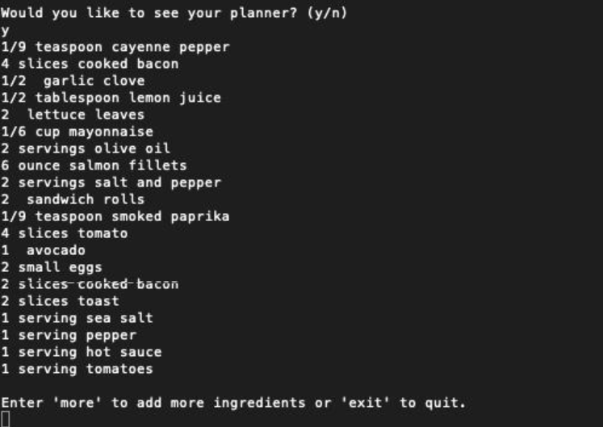
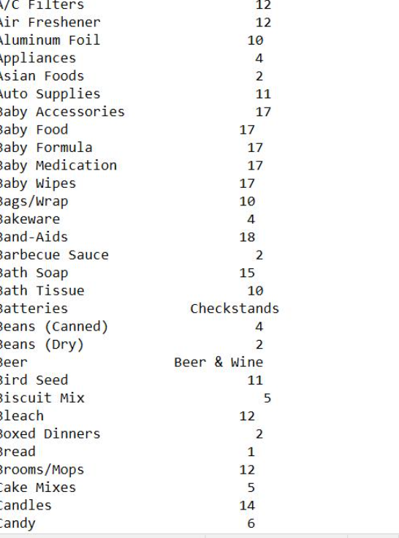
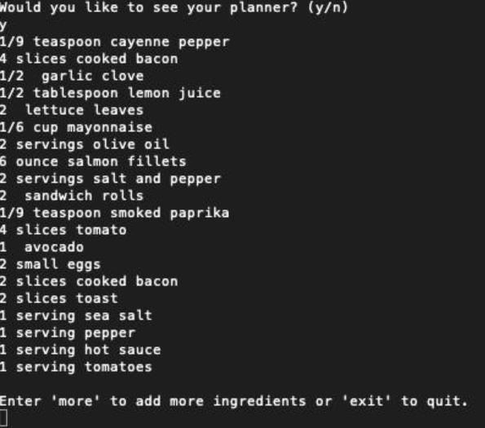
DEMONSTRATION
Screen Shots
Insert screenshot
Insert screenshot
Insert screenshot
MEAL SELECTION
INGREDIENT COLLECTION
FINAL GROCERY LIST

Slide 12
SUBMISSION
Geo Tag Photo & GitHub Link
GITHUB REPOSITORY
https://github.com/chavayashas-alt/KLH_2026-27_T1_PSPJ_mealplanner/security
Insert geo-tag photo
Thank You
Weekly Meal Planner & Grocery Generator
Questions are welcome

